Slide 1





Slide 2


Slide 3


Slide 4



2020 – 2021 Full Year Headlines
Prime focus on employee health during the pandemic
Demand reduced by 25% across the group
Organisational restructure reduced costs by £2M
Brexit managed with no lasting, material impact
Acquisition of PV3 Technologies

Slide 5


Technical Fibre Products
Sales of Fuel Cell products grew significantly
Continued growth in Medical markets & defence
Aerospace demand fell by 65%
Investment to add 50% more capacity restarted
Acquisition of PV3 to accelerate market penetration in Hydrogen
Notes:
Although Aerospace sales are currently impacted, it is noteworthy that development work continues with our customers. We are not seeing any let up in R&D projects for defence end uses.

Slide 6




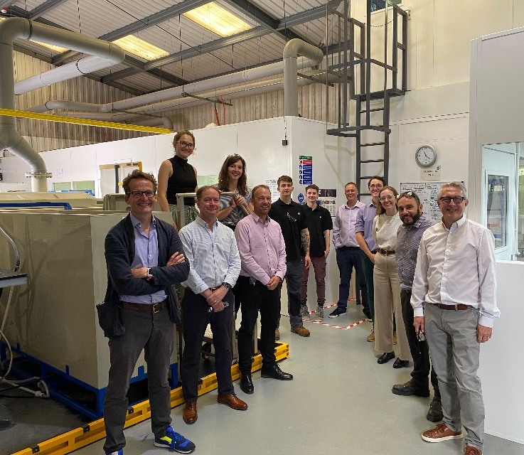
TFP Hydrogen
Established 2011
Based in Launceston, Cornwall
Develop and manufacture electrochemical materials
Specialise in materials for the hydrogen economy
Applications include:
Water electrolysers, fuel cells, batteries, MedTech & water purification

Slide 7
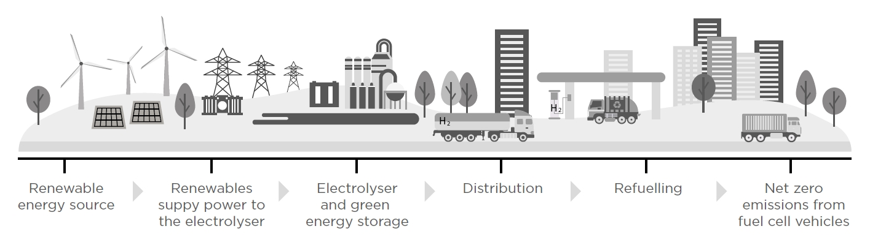


Multiple Entry Points to the Hydrogen Economy
The use of Hydrogen is predicted to grow almost 8-fold by 2050 to fulfil 18% of the world’s final energy demand

Slide 8


Paper Products
Organisation restructure, building strength and reducing cost
Increased resources & capability in sales and technical
On track to achieve 50% reclaimed waste by 2025
New investments for coating and embossing started
Full year impact from Covid-19 reduced demand by 32%

Slide 9

ColourformTM
Sales grew by 9%, with new products launched
Won multiple Luxury Packaging awards
Additional resources in the team to support sales and technical
Strong pipeline supported by Paper Luxury packaging sales team.
Investments planned to support increased capacity and capability
9

Slide 10
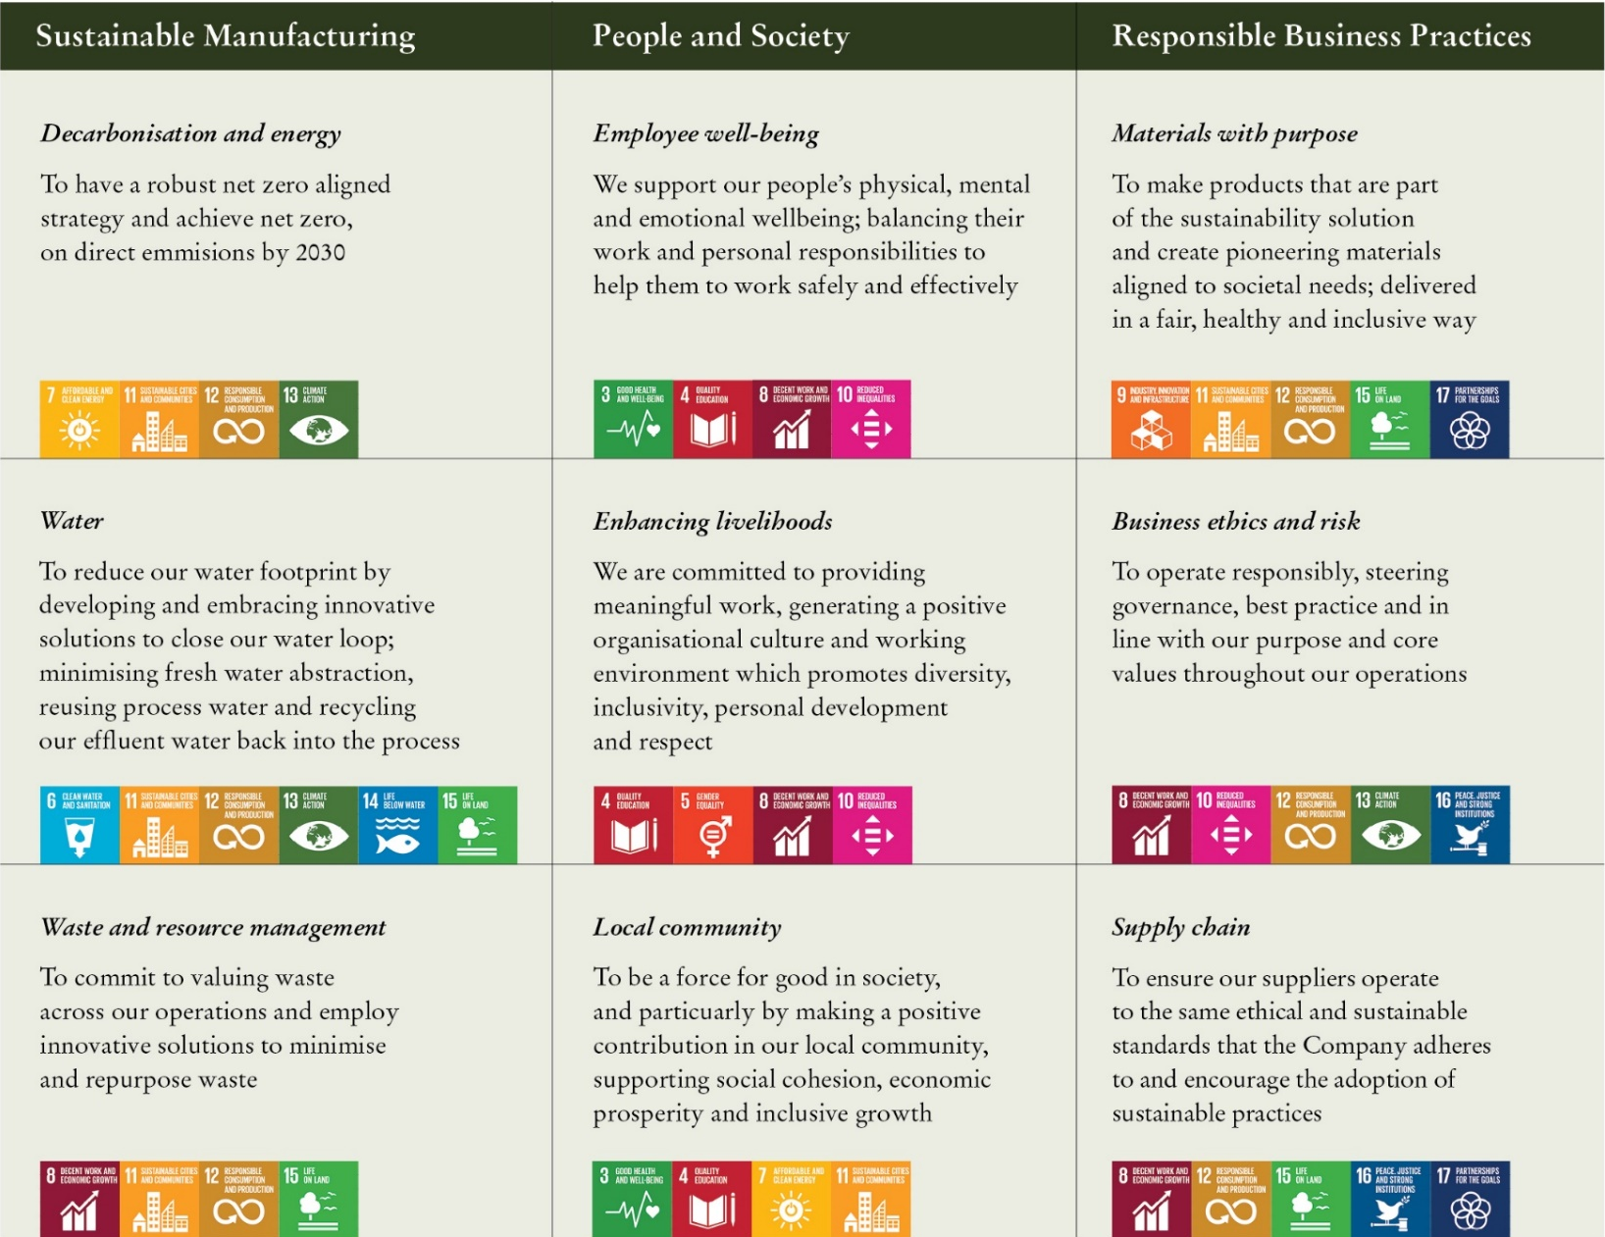
Environmental, Social & Governance
10

Slide 11

Outlook
Group operates 3 vertically integrated businesses – previously a matrix
Demand returning to pre-pandemic levels across the group. Q1 is 50% up on prior year
All investments restarted to support additional capacity and capability
Paper’s costs benefiting from prior year restructure
Confident on the outlook
TFP will leverage new acquisition & additional capacity
11

